Slide 1
Capsular Tension Rings with Premium Lenses
Professor Sunil Shah Birmingham and Midland Eye Centre
London, September 2014

Slide 2
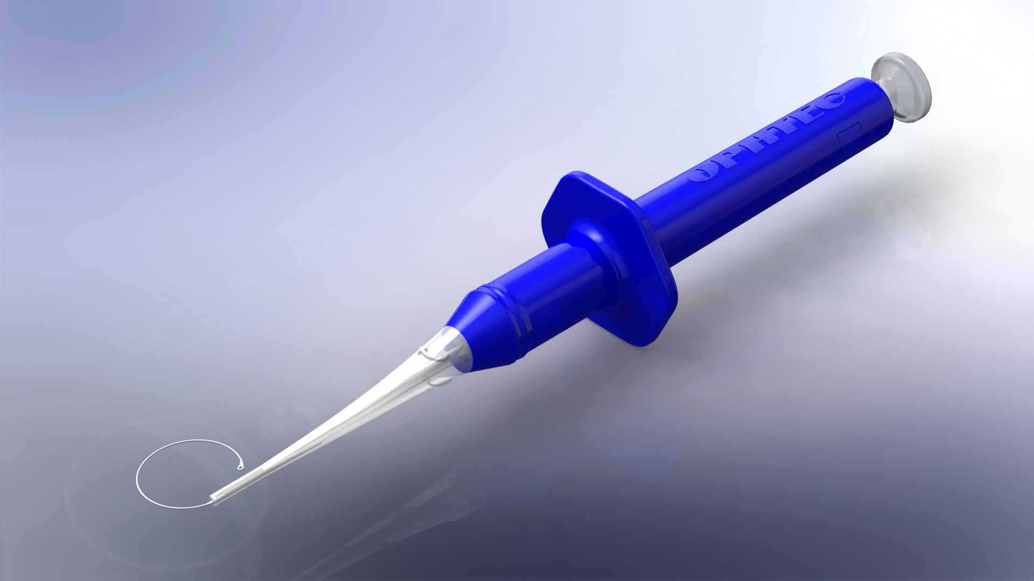
Ringject - Pre Loaded CTR Injector
Why some surgeons do not use a CTR
Reasons for using in a CTR
RingJect unique features
Instructions for use
Technique & Videos
Conclusion: “What I routinely use in all premium lenses”

Slide 3
Why not to use a CTR
Price related issues
Product Availability
Unawareness of benefits by surgeon
Problems with loading and handeling the CTR
No Governmental Refund

Slide 4
Why should one use a CTR
Better Outcomes As The IOL Stay Better Placed In The Eye
More Stable IOL With Less Aberrations And Better Visual Acuity
Delayed Posterior Capsule Opacity
Avoid potential Zonular Damage or Zonular Dehiscence
Good IOL Centration
Avoid IOL tilt
Stabilization Of The Capsular Bag

Slide 5
Why Ophtec’s RingJect
Preloaded: Easy to use
No Sterilization (Pryon, cost,..)
Unique Compression Molded Tech & Reputation
Total implantation safety (spring)
Incision 2.2 mm
Both directions, 1 product code

Slide 6
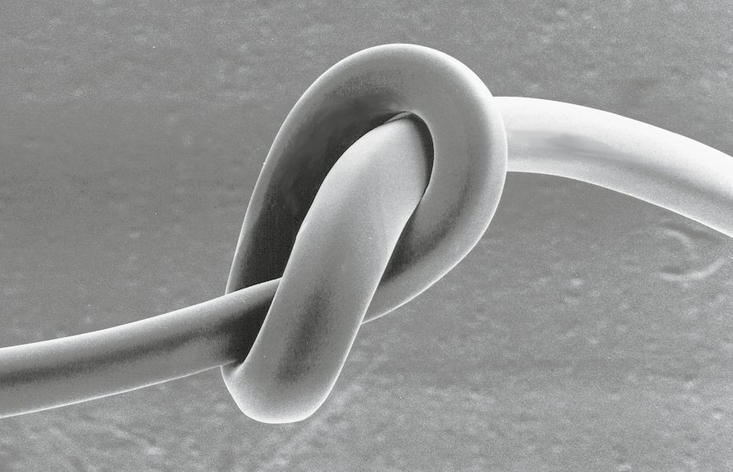
Compression Molding Technology
OPHTEC BV has developed a unique production
process for the manufacturing of CTRs:
Compression Molding Technology. During the compression molding process the molecular structure of PMMA is enhanced by redistributing
the molecules into longer chains, resulting in a much stronger material.
Before
After
Result is an unique and proprietary process that allows the CTR to be extremely flexible with incredible strength. ONLY OPHTEC can tie its tension rings in a knot.

Slide 7
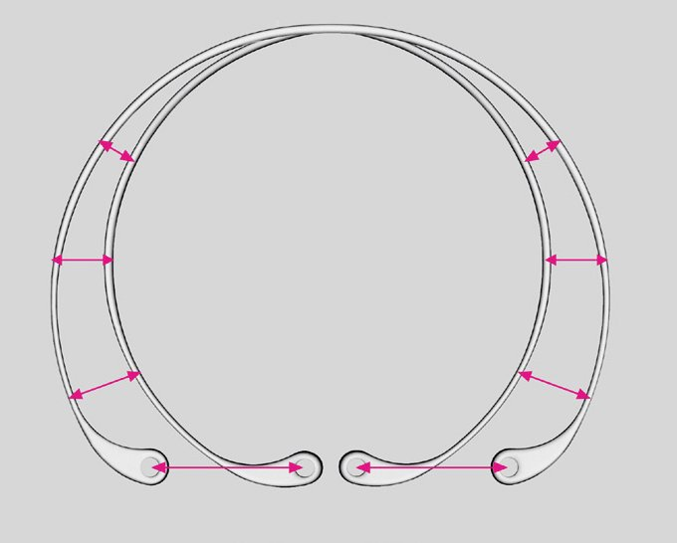
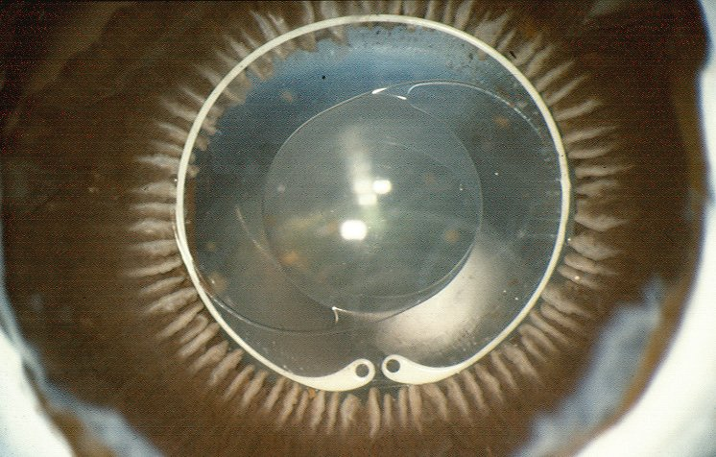
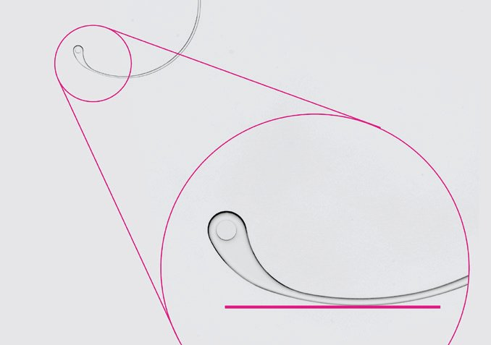
Compression Molding Technology
The Pre-compression shape (oval) becomes perfect circle under full compression.
NOTE: perfectly circular capsule bag.
OPHTEC tension rings are designed to be
more flexible and not deform the capsule
The ends of the rings are gradually formed
to “tip-up” like a ski tip - this allows the
CRT to be easily guided in the capsule as
the ring is dialed-in. The “ski tips” allow the
tips to flow unimpeded in capsule and not
become “snagged”.

Slide 8
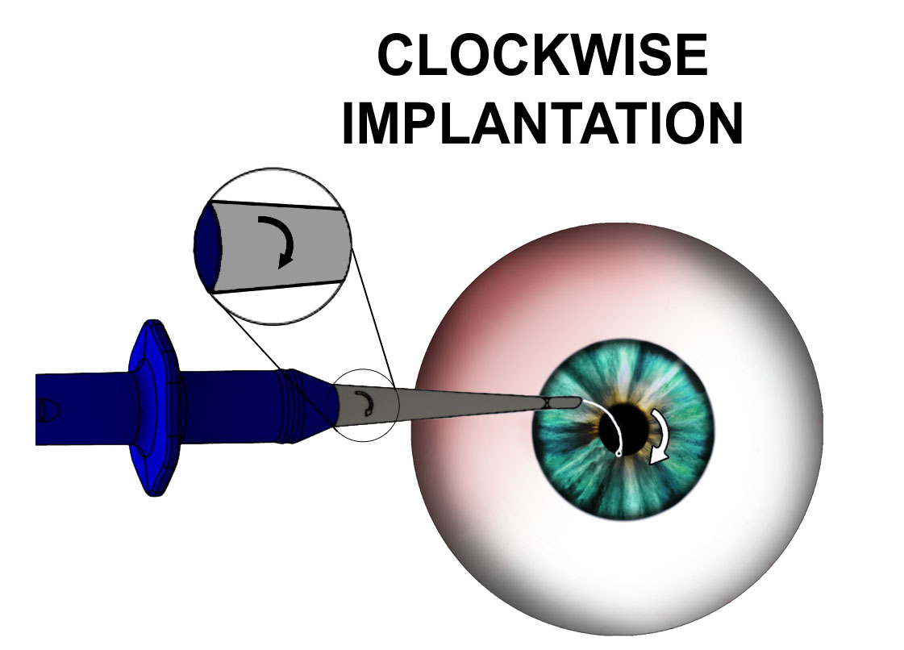
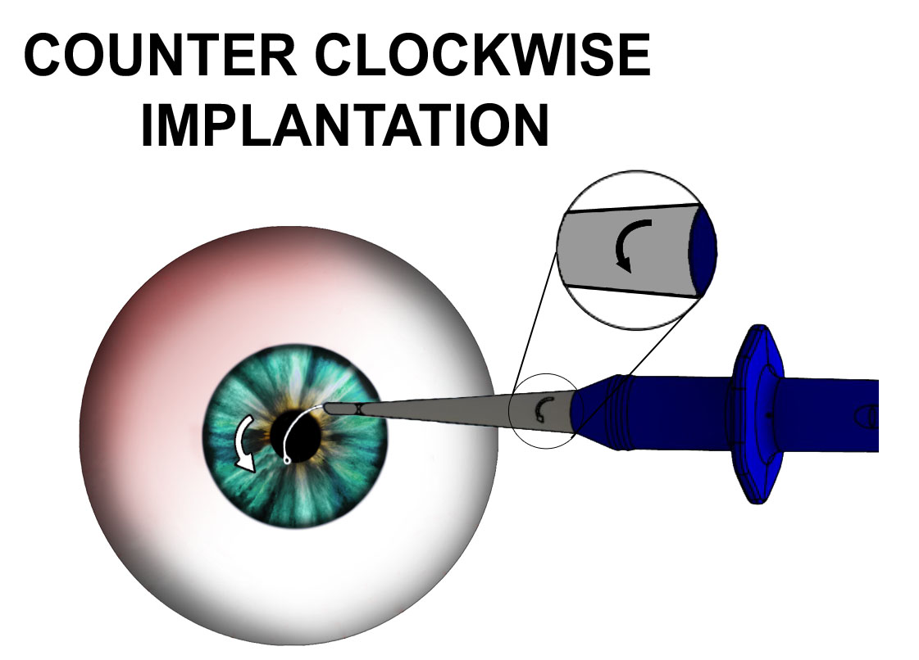
First & Only
First & Only Pre-Loaded CTR with 2 implant options; Clockwise and counter clockwise allowing the surgeon to chose which side of the capsular bag to approach first

Slide 9
Conclusions
“I use CTRs routinely for my premium IOL patients as I believe this ensures good centration and prevents late movement from capsule contraction. In the rare occurrence that the lens needs to be explanted,
it also facilitates surgery as the bag opens up
very easily.
I prefer OPHTEC CTR because they are
preloaded, relatively pliable out of injector so
they insert without any additional tension on
bag and they unhook without manipulation.
Hence they add no significant time on for the surgical procedure”

